Slide 1

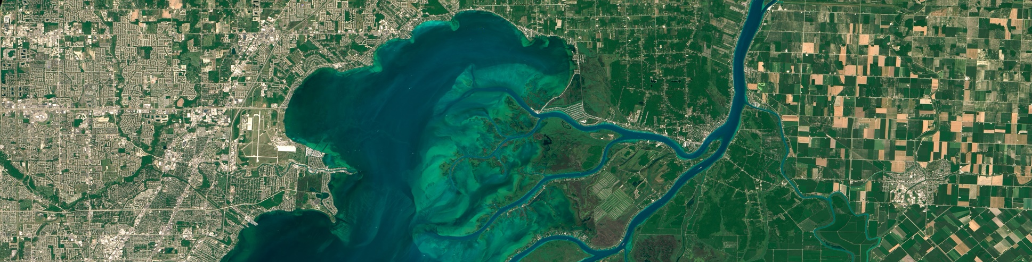
Image classification
From ESA Advanced Training course on Land Remote Sensing by Mário Caetano

Slide 2
Goals
1
From data to information: presentation of different mapping approaches
2
Most common problems in image classification and how to solve them
e.g. mixed pixel problem, lack of normality of the training data, Hughes phenomenon
3
Most important advances in satellite image classification
e.g. from pixel to object, from hard to soft classifiers, from parametric to non-parametric classifiers

Slide 3
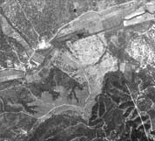
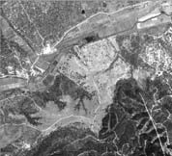
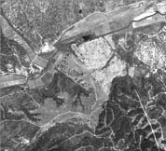
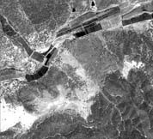


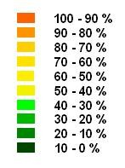
Land information extraction from satellite images
Map of continuous variables
Map of categorical variables
Map of thematic classes
Land cover maps Burned area maps Flooded maps Agriculture maps Forest maps
Leaf area index Biomass
Tree volume
Thematic remote sensing
Quantitative remote sensing
Image classification
Modelling

Slide 4

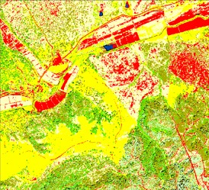

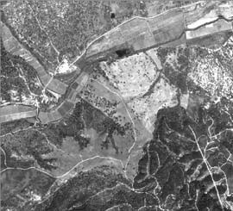

The traditional approach for land cover mapping
Image classification at pixel level
Map of categorical classes

Slide 5
Recent advances in satellite image classification
1. Development of components of the classification algorithm, including training, learning and approaches to class separation
e.g. artificial neural networks, decision trees
2. Development of new systems-level approaches that augment the underlying classifier algorithms
e.g. fuzzy or similar approaches that soften the results of a hard classifier, multiclassifier systems that integrate the outputs of several classification algorithms
3. Exploitation of multiple types of data or ancillary information (numerical and categorical) in the classification process
e.g. use of structural or spatial context information from the imagery, use of multitemporal data, use of multisource data, use of ancillary geographical knowledge in the overall classification system
Source: Wilkinson, 2005

Slide 6
For many years the research emphasis has been on the classification step itself.
Image classification at pixel level
Map of categorical classes
Does it satisfy the user needs?
New classification algorithms
Redefine the approach for thematic information extraction
Recent research
A new spatial unit of analysis
Spatial analysis for map generalisation

Slide 7
Thematic information extraction from satellite images
1
Definition of the mapping approach
*
2
Geographical stratification
3 Image segmentation
4
Feature identification and selection
*
5
Classification
*
6 Ancillary data integration
7
Post-classification processing
8
Accuracy assessment
*
* mandatory

Slide 8
Thematic information extraction from satellite images
1
Definition of the mapping approach
*
2
Geographical stratification
3 Image segmentation
4
Feature identification and selection
*
5
Classification
*
6 Ancillary data integration
7
Post-classification processing
8
Accuracy assessment
*
* mandatory

Slide 9
1. Definition of the mapping approach
The mapping approach has to take into account, e.g.
Characteristics of the satellite data to be used
Definition of the spatial unit of analysis
Technical specifications of the final map (e.g. MMU)
Characteristics of the geographical area to be mapped
Decision on stratifying the study area
Availability of ancillary data
Decision on the use of ancillary data
MMU = Minimum Mapping Unit

Slide 10
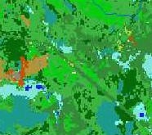
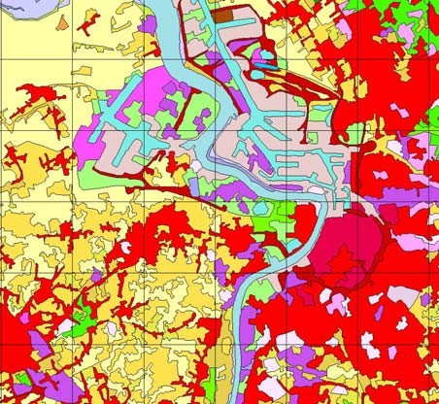
1. Definition of the mapping approach
Minimum Mapping Unit (MMU)
The MMU is the smallest area that is represented in a map
In raster maps the MMU usually is the pixel
In vector maps the MMU is the smallest object that is represented in the map
e.g. in the NLCD 2001 (USA) the MMU is 30x30 m pixel
e.g. in the CORINE Land Cover (CLC) maps (from EEA) the MMU is 25 ha
NLCD = National Land Cover Database EEA – European Environment Agency

Slide 11
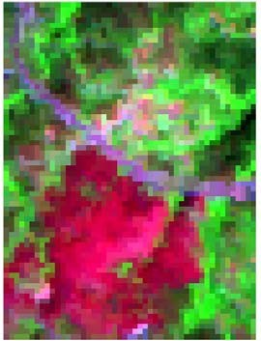
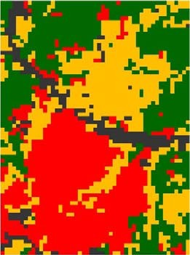

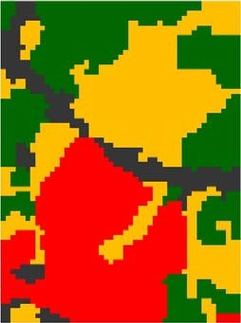
1. Definition of the mapping approach
Spatial unit of analysis
This is the unit to which the classification algorithms will be applied
Image pixel
Per pixel or sub- pixel classification
Object
Object oriented image classification

Slide 12
1. Definition of the mapping approach
The selection of the spatial unit of analysis depends on:
Spatial resolution of the satellite image
Type of thematic information we want to extract, e.g. land cover, land use Format of the map we want to produce, i.e. vector or raster
Minimum Mapping Unit of the final map
Post-processing tasks that we are planning to apply

Slide 13
1. Definition of the mapping approach
The steps required to information extraction depend on the defined mapping approach:
Map format = raster
MMU = pixel size of input satellite data
Feature selection > Image classification > accuracy assessment
MMU > pixel size of input satellite data
Feature selection > Image classification > post-processing > accuracy assessment
Map format = vector
upscaling
Spatial unit of analysis = image pixel
Feature selection > Image classification > post-processing > accuracy assessment
Spatial unit of analysis = object
Generalisation + Raster to vector conversion
Image segmentation > Feature selection > Image classification > post-processing > accuracy assessment
Generate the objects
Generalisation

Slide 14
Thematic information extraction from satellite images
1
Definition of the mapping approach
*
2
Geographical stratification
3 Image segmentation
4
Feature identification and selection
*
5
Classification
*
6 Ancillary data integration
7
Post-classification processing
8
Accuracy assessment
*
* mandatory

Slide 15
2. Geographical stratification
Geographical stratification – the study area is divided into smaller areas (strata) so that each strata can be processed independently.
Five general concepts are useful in geographical stratification:
economics of size,
type of physiography,
potential land cover distribution,
potential spectral uniformity,
edge-matching issues.
Data that can be used for geographical stratification
Slope
Vegetation maps
Aspect
Climate data
Elevation
Existent land cover/use maps

Slide 16
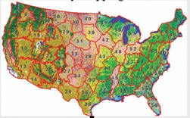
2. Geographical stratification
Geographical stratification used on the production of the US National Land Cover Database (NLCD) - 2001
Input data
83 Level III ecoregions developed by Omernik
NLCD 1992
AVHRR normalized greenness maps
AVHRR - Advanced Very High Resolution Radiometer
Source: Homer et al. (2004)

Slide 17
Thematic information extraction from satellite images
1
Definition of the mapping approach
*
2
Geographical stratification
3
4
Feature identification and selection
*
5
Classification
*
6 Ancillary data integration
7
Post-classification processing
8
Accuracy assessment
*
* mandatory

Slide 18
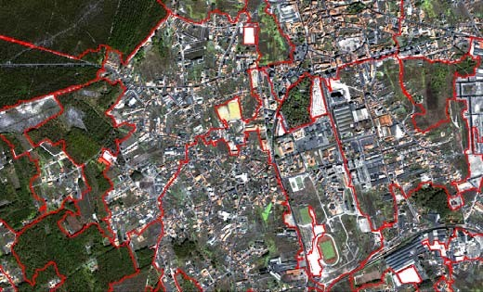
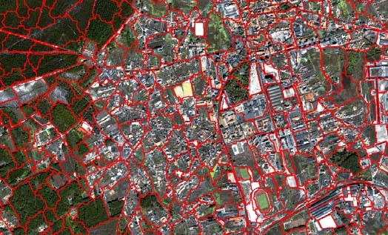
3. Image segmentation
This step is only required if the spatial unit of analysis is the object.
Segmentation is the division of an image into spatially continuous, disjoint and homogeneous regions, i.e. the objects.
Segmentation of an image into a given number of regions is a problem with a large number of possible solutions.
There are no “right” or “wrong” solutions to the delineation of landscape objects but instead “meaningful” and “useful” heuristic approximations of partitions of space.

Slide 19
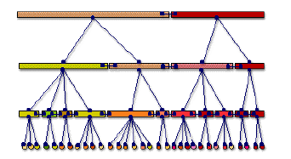
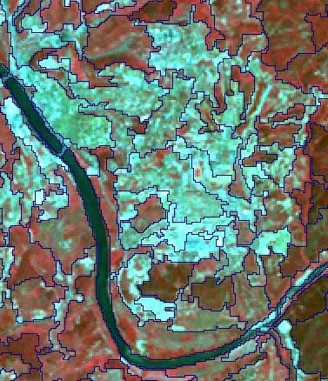
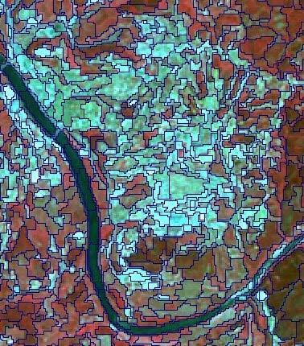
3. Image segmentation
A type of segmentation that is very common is the multi-resolution segmentation, because of its ability to deal with the range of scales within a single image.
Super-objects
Sub-objects

Slide 20
Thematic information extraction from satellite images
1
Definition of the mapping approach
*
2
Geographical stratification
3 Image segmentation
4
Feature identification and selection
*
5
Classification
*
6 Ancillary data integration
7
Post-classification processing
8
Accuracy assessment
*
* mandatory

Slide 21
4. Feature identification and selection
What type of features can we use for information extraction?
Should we, for some reason, manipulate the feature space? How can we select the best features for class discrimination?
Manipulation and selection of features are used to reduce the number of features without sacrifying accuracy

Slide 22
4. Feature identification and selection
Spectral measurements
1st order measurements
From a single date (Unitemporal approach) From multiple dates (Multi-temporal approach
Secondary measurements derived from the image
2nd order measurements
Measurements of the spatial unit being classified
Measurements related to the neighbourhood
Quantification of the spatial variability within the neighbourhood Texture
Spatial features
Semantic relationships of a spatial unit with its neighbours
Ancillary information
This term is generally used for non-spectral geographical information
Data from images with different characteristics can also be considered as ancillary information. The approaches used for multisensor data may fall within data fusion.

Slide 23
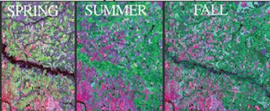
4. Feature identification and selection
1st order measurements
Unitemporal approach Multi-temporal approach
The production of the US National Land Cover Database (NLCD) – 2001 is based on a multi-temporal approach
It helps to discriminate classes with different phenology
Irrigated and rain fed agriculture Permanent and deciduous forests
Source: Homer et al. (2004)

Slide 24
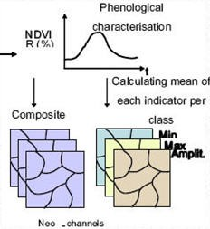
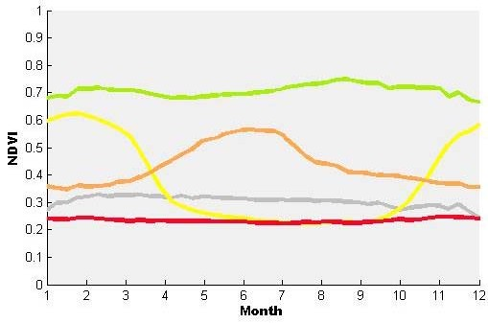
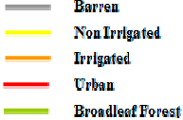
4. Feature identification and selection
2nd order measurements
Measurements of the spatial unit being classified
In the GLOBCOVER project (ESA) a set of new- channels based on the annual NDVI profile are derived.
Source: Defourny et al. (2005)

Slide 25
4. Feature identification and selection
2nd order measurements
Measurements related to the neighbourhood (contextual information)
Most mapping approaches operate at a pixel level, ignoring its context
Several attempts have been carried out to take into automatic classification the contextual information.
Contextual information and semantic relationships with neighbours is always used by photo-interpreters in visual analysis.
Fractals
Texture
First order statistics in the spatial domain
Second order statistics in the spatial domain
Geostatistics
(e.g., variogram, correlogram, covariance function)
(e.g. mean, variance, standard deviation, entropy)
(e.g. homogeneity, dissimilarity,
entropy, angular second moment, contrast, correlation)

Slide 26
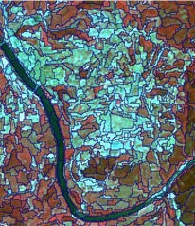
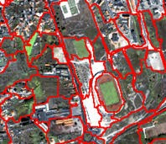
4. Feature identification and selection
…some considerations on object oriented image classification
In object oriented image classification one can use features that are very similar to the ones used on visual image interpretation
Shape and size of the objects
Spectral homogeneity within objects
Semantic relationships of a spatial unit with its neighbours
Before object oriented image classification there was the per-field classification. In this approach the objects are not extracted from the satellite image through segmentation but instead from an existent geographical data base with landscape units, i.e. fields.

Slide 27
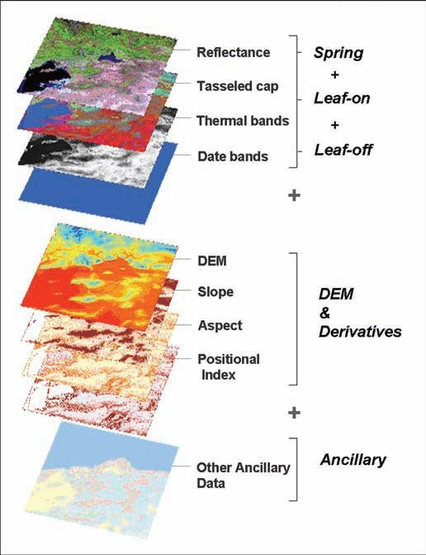
4. Feature identification and selection
Ancillary information
continuous
e.g. elevation, slope, aspect
categorical
e.g. soil type, existent land cover maps
US National Land Cover Database 2001
Source: Homer et al. (2007)

Slide 28
Thematic information extraction from satellite images
1
Definition of the mapping approach
*
2
Geographical stratification
3 Image segmentation
4
Feature identification and selection
*
5
Classification
*
6 Ancillary data integration
7
Post-classification processing
8
Accuracy assessment
*
* mandatory

Slide 29
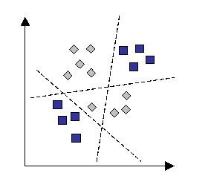
5. Classification
Allocation of a class to each spatial unit of analysis (SUA)
Map of categorical classes
Image spatial space
Each SUA is represented by a vector, consisting of a set of measurements (e.g. reflectance)
Band 2
Definition of decision boundaries to separate classes
Definition of the decision rule, i.e. the algorithm that defines the position of a SUA with respect to the decision boundaries and that allocates a specific label to that SUA
Image feature space
Band 1
The word classifier is widely used as a synonym of the term decision rule

Slide 30
5. Classification
Artificial intelligence
Data mining
satellite image classification
natural language processing
syntactic pattern recognition
search engines
medical diagnosis
bioinformatics
cheminformatics
stock market analysis
classifying DNA sequences
speech recognition,
handwriting recognition
object recognition in computer vision
game playing
robot locomotion
Computer sciences
Statistics
Pattern recognition
Machine learning

Slide 31
5. Classification
Different possibilities to
categorise classifiers
Type of learning
Number of outputs for each spatial unit
supervised
unsupervised
Hard (crisp) |  | Soft (fuzzy)
Assumptions on data distribution
Parametric
Non-parametric

Slide 32
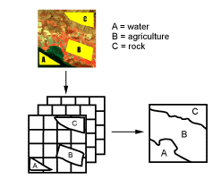
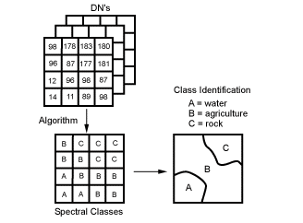
5. Classification
Type of learning
Supervised classification
Unsupervised classification
Source: CCRS

Slide 33
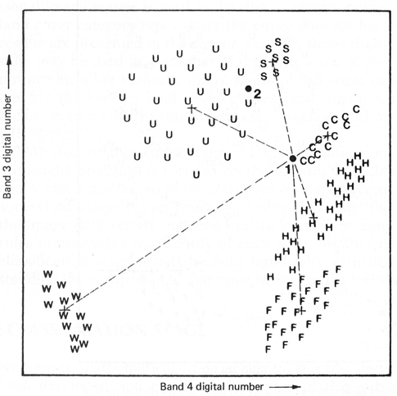
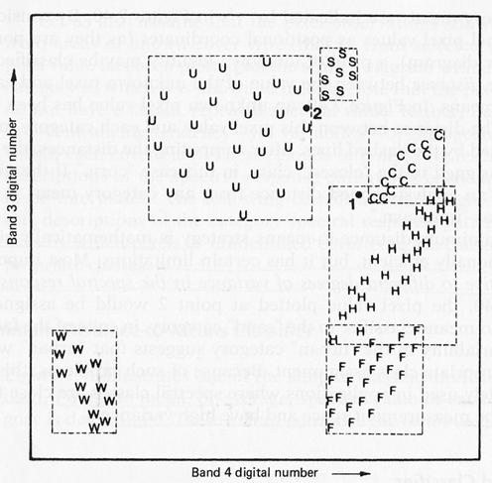
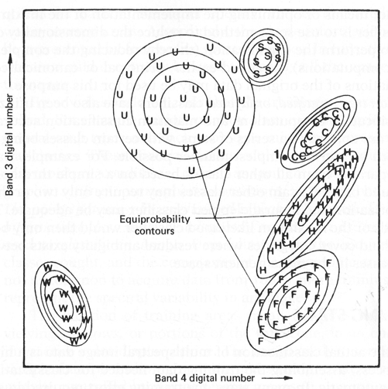
5. Classification
Classic supervised classifiers
Minimum distance
Parallelepiped
Maximum likelihood
Source: Jensen (1996)

Slide 34
5. Classification
Some considerations on the training stage…
The training phase is decisive on the final results of image classification. In fact, in these phase we collect the data that will be used to train the algorithm.
The usual restrictions on sampling (cost, availability of data and accessibility) may lead to an inadequate sampling.
In case of parametric classifiers the number of sample observations affect strongly the estimates of the statistical parameters.
As the dimensionality of the data increases for a fixed sample size so the precision of the statistical parameters become lower (i.e., Hughes phenomenon).
It is common that even mixed pixels dominate the image, only pure pixels are selected for training. However, this may lead to unsatisfactory classification accuracy.

Slide 35
5. Classification
Assumptions on data distribution
Non- parametric classifiers
Parametric classifiers
e.g., maximum likelihood classifier
e.g., decision trees, artificial neural networks, support vector machines, nearest neighbour
Traditionally most classifiers have been grounded to a significant degree in statistical decision theory.
These classifiers rely on assumptions of data distribution.
The performance of a parametric classifier depends largely on how well the data match the pre-defined models and on the accuracy of the estimation of the model parameters.
They suffer from the Hughes phenomenon (i.e. curse of dimensionality), and consequently it might be difficult to have a significant number of training pixels.
They are not adequate to integrate ancillary data (due to difficulties on classifying data at different measurement scales and units).

Slide 36
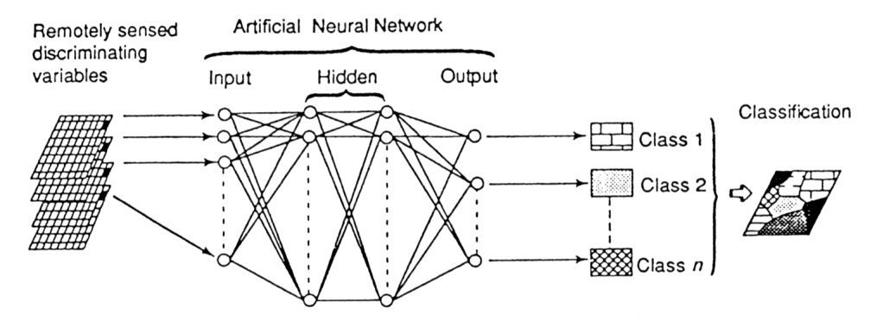
5. Classification
Non-parametric classifiers Artificial Neural Networks
An ANN is a form of artificial intelligence that imitates some functions of the human brain.
An ANN consists of a series of layers, each containing a set of processing units (i.e. neurones)
All neurones on a given layers are linked by weighted connections to all neurones on the previous and subsequent layers.
During the training phase, the ANN learns about the regularities present in the training data, and based on these regularities, constructs rules that can be extended to the unknown data
Source: Foody (1999)

Slide 37
5. Classification
Non-parametric classifiers
Artificial Neural Networks
ANN
ANN
Type of learning
Number of output labels
Supervised
Unsupervised
Hard
Soft
Most common types of ANN
Multi-layer perceptron with back-propagation Self-organised feature map (SOM)
Hopfield networks
ART (Adaptive Ressonance Theory) Systems

Slide 38
5. Classification
Non-parametric classifiers Artificial Neural Networks Advantages of ANN
It is a non-parametric classifier, i.e. it does not require any assumption about the statistical distribution of the data.
High computation rate, achieved by their massive parallelism, resulting from a dense arrangement of interconnections (weights) and simple processors (neurones), which permits real-time processing of very large datasets.
Disadvantages of ANN
ANN are semantically poor. It is difficult to gain any understanding about how the result was achieved.
The training of an ANN can be computationally demanding and slow.
ANN are perceived to be difficult to apply successfully. It is difficult to select the type of network architecture, the initial values of parameters such as learning rate and momentum, the number of iterations required to train the network and the choice of initial weights.

Slide 39
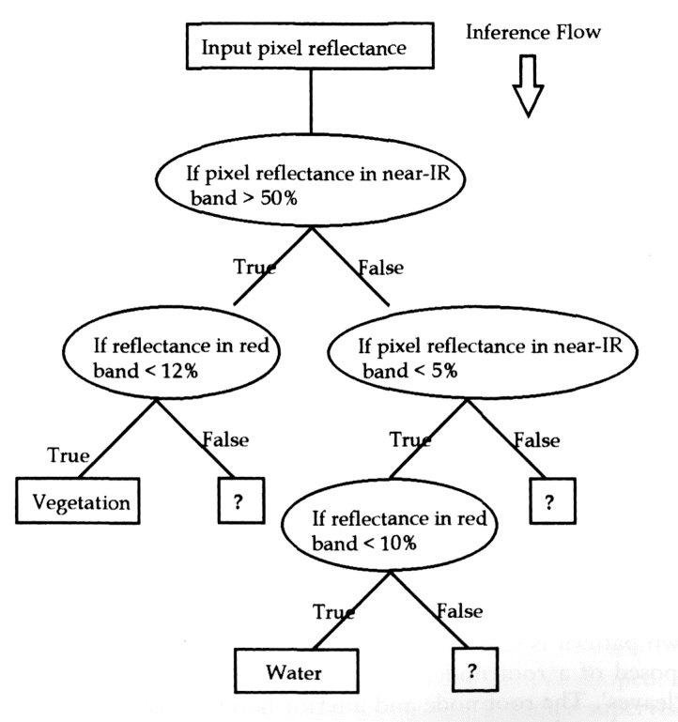
5. Classification
Non-parametric classifiers
Decision Trees
DT are knowledge based (i.e. a method of pattern recognition that simulates the brains inference mechanism).
DT are hierarchical rule based approaches.
DT predict class membership by recursively partitioning a dataset into homogeneous subsets.
Different variables and splits are then used to split the subsets into further subsets.
There are hard and soft (fuzzy) DT.
Source: Tso and Mather (2001)

Slide 40
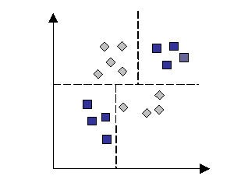
5. Classification
Non-parametric classifiers Advantages of DT
Decision Trees
Ability to handle non-parametric training data, i.e. DT are not based on any assumption on training data distribution.
DT can reveal nonlinear and hierarchical relationships between input variables and use these to predict class membership.
DT yields a set of rules which are easy to interpret and suitable for deriving a physical understanding of the classification process.
DT, unlike ANN, do not need an extensive design and training. Good computational efficiency.
Disadvantages of DT
The use of hyperplane decision boundaries parallel to the feature axes may restrict their use in which classes are clearly distinguishable.

Slide 41
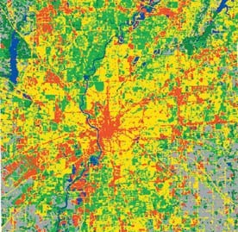
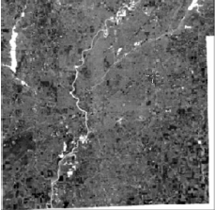
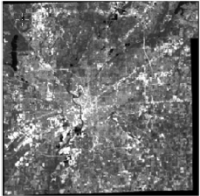
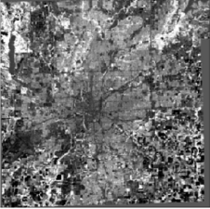
5. Classification
Number of outputs for each spatial unit
Hard (crisp) classification
Soft (fuzzy) classification
each pixel is forced or constrained to show membership to a single class.
each pixel may display multiple and partial class membership.
Veg.
Water
Bare soil
Soft classification has been proposed in the literature as an alternative to hard classification because of its ability to deal with mixed pixels.

Slide 42
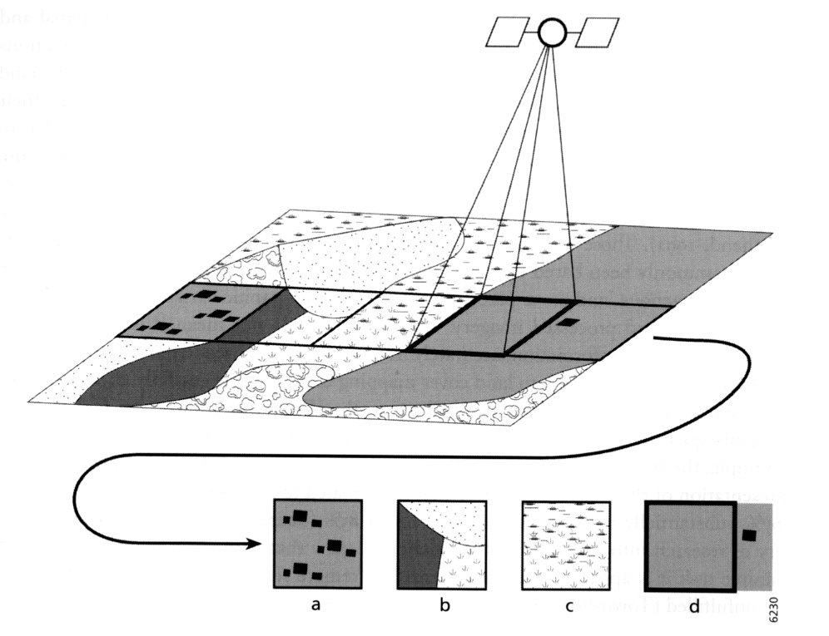
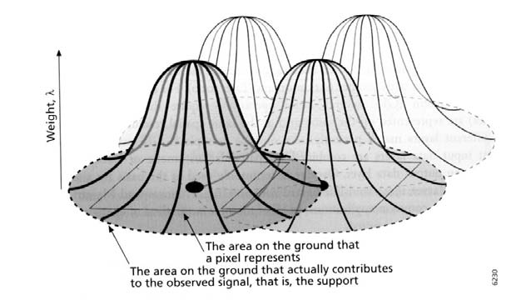
5. Classification
The mixed pixel problem
A – presence of small, sub-pixel targets
B – presence of boundaries of discrete land cover classes
C – gradual transition between land cover classes (continuum)
D – contribution of areas outside the area represented by a pixel
Source: Foody (2004)

Slide 43
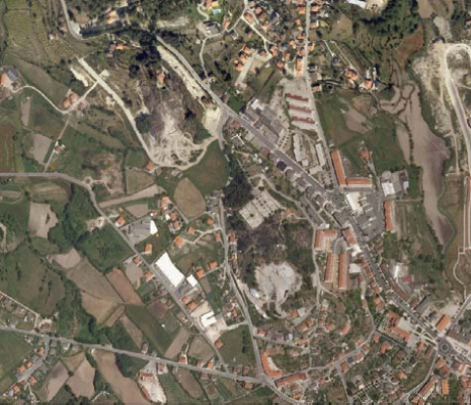
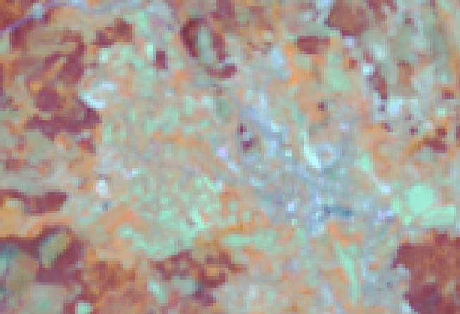
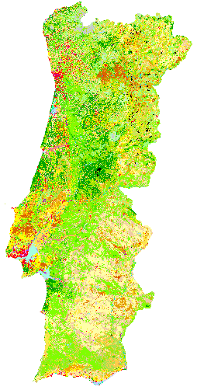
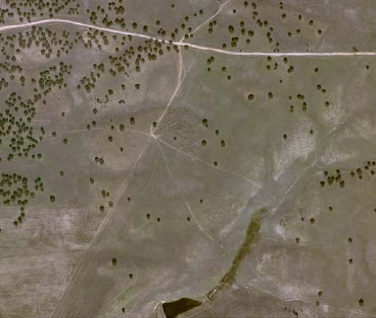
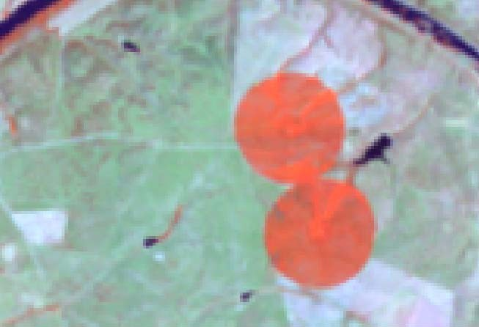
5. Classification
The number of mixed pixels in an image varies mainly with: ^{The mixed pixel problem}
Landscape fragmentation Sensor’s spatial resolution
MERIS FR pixels

Slide 44

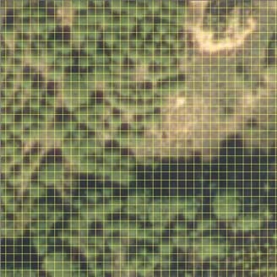
5. Classification
The mixed pixel problem
The problem of mixed pixels exist in coarse and fine resolution images:
In course resolution images the mixed pixels are mainly due to co-existence in the same pixel of different classes.
MERIS FR
In fine resolution images the mixed pixels are mainly due to co-existence in the same pixel of different components (e.g., houses, trees).
IKONOS

Slide 45
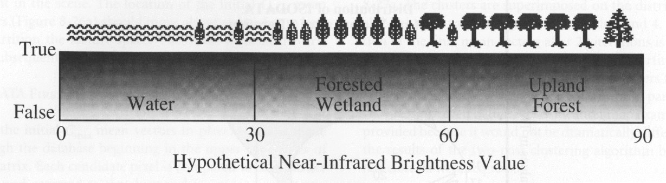
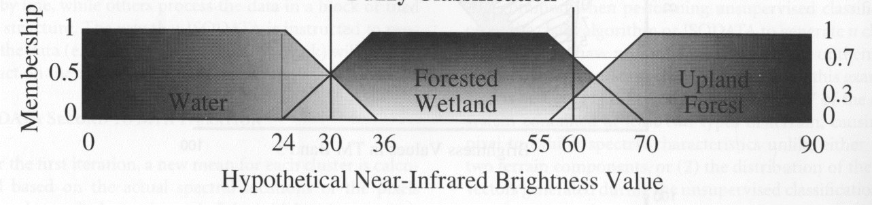
5. Classification
Hard classification
Decision rules
0 – 30 -> Water
30 - 60 -> Forest wetland
60 - 90 -> Upland forest
Fuzzy classification
Decision rules are defined as membership functions for each class.
Membership functions allocates to each pixel a real value between 0 and 1, i.e. membership grade.
But, wow can we represent the sub-pixel information?
Source: Jensen (1996)

Slide 46
5. Classification
How can we represent the sub-pixel information?
Sub-pixel scale information is typically represented in the output of a soft classification by the strength of membership a pixel displays to each class.
Veg.
Water
Bare soil
It is used to reflect the relative proportion of the classes in the area represented by the pixel

Slide 47
5. Classification
How can we represent the sub-pixel information?
Map with primary and secondary classes
Entropy image
The pixel value translates a degree of mixing (entropy is minimised when the pixel is associated with a single class and maximised when membership is partitioned evenly between all of the defined classes).
Hill’s diversity numbers image
The pixel values provides information on the number of classes, the number of abundant classes and the number of very abundant classes.

Slide 48
5. Classification
Soft classifiers
Most common soft classifiers
Maximum likelihood classification Fuzzy c-means
Approaches based on fuzzy set theory
Possibilistic c-means
Fuzzy rule based classifications
Artificial neural networks

Slide 49
5. Classification
Classification
Soft classifiers
Some considerations on uncertainty
Maximum likelihood classifier (MLC)
MLC is one of the most widely used hard classifier.
In a standard MLC each pixel is allocated to the class with which it has the highest posterior probability of class membership.
MLC has been adapted for the derivation of sub-pixel information.
This is possible because a by-product of a conventional MLC are the posterior probabilities of each class for each pixel.
The posterior probability of each class provides is a relative measure of class membership, and can therefore be used as an indicator of sub-pixel proportions.
Some authors use the term Fuzzy MLC, to discriminate it from the (hard) MLC.
Conceptually, there is not a direct link between the proportional coverage of a class and its posterior probability. In fact, posterior probabilities are an indicator of the uncertainty in making a particular class allocation. However many authors have find that in practice useful sub-pixel information can be derived from this approach.

Slide 50
5. Classification
Soft classifiers
The continuum of classification fuzziness
In the literature the term fuzzy classification has been used for cases where fuzziness is only applied to the allocation stage – which does not seem to be completely correct.
If we apply the concept of fuzziness to all stages of image classification we can create a continuum of fuzziness, i.e. a range of classification approaches of variable fuzziness.
Completely-crisp classification
Fully-fuzzy classification
Classification stages
Dominant class
Training
Individual class proportions
Membership grade to all classes
Pixel is allocated to a single class
Allocation
Dominant class
Testing
Individual class proportions
Source: Foody (2004)

Slide 51
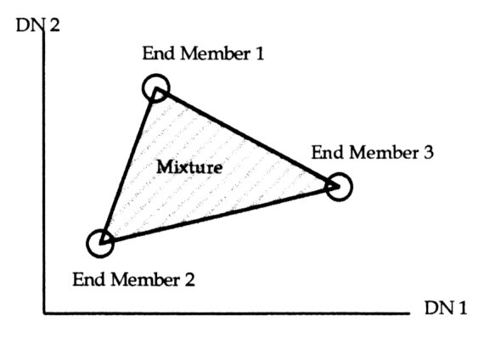
5. Classification
Spectral unmixing
Spectral unmixing = spectral mixture modelling = spectral mixture analysis Spectral unmixing is an alternative to soft classification for sub-pixel analysis.
Spectral unmixing is based on the assumption that spectral signature of satellite images results essentially from a mixture of a small number of pure components (endmembers) with characteristic spectra.
If so, it is then possible to use a limited number of components so that mixtures of these component spectra adequately simulate the actual observations.
Linear mixture models are the most common models used in satellite image analysis
N
DN_{c} = ∑ F_{n} DN_{n1c} + E_{c}
1
DNc –image radiance for band c
N – is the number of endmembers
Source: Tso and Mather (2000)
F_{n} – is the relative fraction of endmember n DNn.c – is the endmember n inner radiance Ec –residual fitting error

Slide 52
5. Classification
Spectral unmixing
A case study: urban mapping
Lu and Weng (2004) used Spectral Mixture Analysis for mapping the Urban Landscape in Indianapolis with Landsat ETM+ Imagery.
SMA was used to derive fraction images to three endmembers: shade, green vegetation, and soil or impervious surface
Output of spectral unmixing
Shade fraction
Vegetation fraction
Soil or impervious surface fraction

Slide 53


5. Classification
Spectral unmixing
A case study: urban mapping
Pasture and Agricultural lands
Lu-Weng urban landscape model
= commercial + industrial
The fraction images were used to classify LULC classes based on a hybrid procedure that combined maximum-likelihood and decision-tree algorithms.
Source: Lu and Weng (2004)

Slide 54
5. Classification
Sub-pixel classification
Super-resolution mapping
Although classification at sub-pixel level is informative and meaningful it fails to account for the spatial distribution of class proportions within the pixel.
Super-resolution mapping (or sub-pixel mapping) is a step forward.
Super-resolution mapping considers the spatial distribution within and between pixels in order to produce maps at sub-pixel scale.
Several approaches of super-resolution mapping have been developed:
Hopfield neural networks
Pixel-swapping solution (based on geostatistics) Linear optimization
Markov random fields

Slide 55

5. Classification
Sub-pixel classification
Super-resolution mapping
Pixel-swapping solution – this technique allows sub-pixel classes to be swapped within the same pixel only.
Swaps are made between the most and least attractive locations if they result in an increase in spatial correlation between sub-pixels.
Source: Atikson (2004)

Slide 56
5. Classification
Multiple classifiers approach
Rationale
Different classifiers originate different classes for the same spatial unit
There are several studies on the comparison of different classifiers
There is not a single classifier that performs best for all classes. In fact it appears that many of the methods are complementary
Combination of decision rules can bring advantages over the single use of a classifier
In the multiple classifiers approach the classifiers should be independent. To be independent the classifiers must use an independent feature set or be trained on separate sets of training data.

Slide 57



5. Classification
Multiple classifiers approach
How different the results from different classifiers can be?
Maximum likelihood
Artificial Neural Networks
Decision tree
Source: Gahegan and West (1998)

Slide 58
5. Classification
Multiple classifiers approach
Methods for combining classifiers
Voting rules
The label outputs from different classifiers are collected and the majority label is selected (i.e. majority vote rule). There are some variants, such as the comparative majority voting (it requires that the majority label should exceed the 2nd more voted by a specific number).
Bayesian formalism
It is used with multiple classifiers that output a probability. The probabilities for a spatial unit for each class resulting from different classifiers are accumulated and the final label is the one that has the greatest accumulated probability.
Evidential reasoning
It associates a degree of belief with each source of information, and a formal system of rules is used in order to manipulate the belief function.
Multiple neural networks
It consists on the use of a neural network to produce a single class to each spatial unit, fed with the outputs from different classifiers.

Slide 59
5. Classification
spectral secondary measurements
geographical
a summary on image classification…
(sub-pixel) pixel object
Vector of features
describing a spatial unit
The aim of pattern recognition
is to establish a link between a pattern and a
class label
one to one
one to many
hard classification
soft classification
known
unknown
supervised classification
unsupervised classification

Slide 60
Thematic information extraction from satellite images
1
Definition of the mapping approach
*
2
Geographical stratification
3 Image segmentation
4
Feature identification and selection
*
5
Classification
*
6
Ancillary data integration
7
Post-classification processing
8
Accuracy assessment
*
* mandatory

Slide 61
6. Ancillary data integration
Ancillary data can be integrated after image classification in order to improve the results.
Post-classification sorting - application of very specific rules to classification results and to geographical ancillary data (e.g., elevation, slope, aspect)
There are several strategies based on expert systems, rule based systems and knowledge base systems

Slide 62
Thematic information extraction from satellite images
1
Definition of the mapping approach
*
2
Geographical stratification
3 Image segmentation
4
Feature identification and selection
*
5
Classification
*
6 Ancillary data integration
7
Post-classification processing
8
Accuracy assessment
*
* mandatory

Slide 63
7. Post-classification processing
Post processing is required in two cases
The Minimum Mapping Unit of the very final map is larger than the spatial unit used in the classification
The final map has a vector format and the Spatial Unit of Analysis was the pixel
Map generalisation
Raster to vector conversion
Upscaling

Slide 64
7. Post-classification processing
The steps required to information extraction depend on the defined mapping approach:
Map format = raster
MMU = pixel size of input satellite data
Feature selection > Image classification > accuracy assessment
MMU > pixel size of input satellite data
Feature selection > Image classification > post-processing > accuracy assessment
Map format = vector
upscaling
Spatial unit of analysis = image pixel
Feature selection > Image classification > post-processing > accuracy assessment
Spatial unit of analysis = object
Generalisation + Raster to vector conversion
Image segmentation > Feature selection > Image classification > post-processing > accuracy assessment
Generate the objects
Generalisation

Slide 65


7. Post-classification processing
Semantic generalisation
Semantic generalisation
MMU = 1 pixel (30mx30m)
MMU = 5 ha

Slide 66







7. Post-classification processing
Semantic generalisation
MMU = 1 pixel (30mx30m)
1
MMU = 5 ha
Shrubland Forest
Agriculture Bare soil
2
3

Slide 67
Thematic information extraction from satellite images
1
Definition of the mapping approach
*
2
Geographical stratification
3 Image segmentation
4
Feature identification and selection
*
5
Classification
*
6 Ancillary data integration
7
Post-classification processing
8
Accuracy assessment
*
* mandatory

Slide 68



8. Accuracy assessment
Accuracy assessment allows users to evaluate the utility of a thematic map for their intended applications.
The most widely used method for accuracy assessment may be derived from a confusion or error matrix.
The confusion matrix is a simple cross- tabulation of the mapped class label against the observed in the ground or reference data for a sample set.

Slide 69
8. Accuracy assessment
Main steps
Probability sampling is necessary if one wants to extend the results obtained on the samples to the whole map.
Probability sampling requires that all inclusion probabilities be greater than zero, e.g. one cannot exclude from sampling inaccessible areas or landscape unit borders.
1Selection of the reference sample
sampling units sampling design
2 Response design
The definition of the response design depends on the process for assessing agreement (e.g., primary, fuzzy or quantitative).
3 Analysis and estimation
One has to take into account the known areas (marginal distributions) of each map category to derive unbiased estimations of the proportion of correctly mapped individuals.
Source: Stehman (1999)

Slide 70






8. Accuracy assessment
Overall accuracy: 86%
Small uncertainty
Moderate uncertainty
Large uncertertainty
But, where is the error?
Uncertainty mapping

Slide 71
Goals
1
From data to information: presentation of different mapping approaches
2
Most common problems in image classification and how to solve them
e.g. mixed pixel problem, lack of normality of the training data, Hughes phenomenon
3
Most important advances in satellite image classification
e.g. from pixel to object, from hard to soft classifiers, from parametric to non-parametric classifiers

Slide 72
References
Atkinson, P.M., 2004, Resolution manipulation and sub-pixel mapping, in S.M. de Jong and F.D. van der Meer (eds), Remote sensing image analysis – including the spatial domain, Dordrecht: Kluwer Academic Publishers.
Defourny, P., Vancutsem, C., Bicheron, P, Brockmann, C., Nino, F., Schouten, L., Leroy, M., 2006, GLOBCPVER: a 300m global land cover product for 2005 using ENVISAT MERIS Time Series, Proceedings of ISPRS Commission VII Mid-Term Symposium: Remote Sensing: from Pixels to Processes, Enschede (NL), 8-11 May, 2006
Foody, G. M., 2004, Sub-pixel methods in remote sensing, in in S.M. de Jong and F.D. van der Meer (eds), Remote sensing image analysis – including the spatial domain, Dordrecht: Kluwer Academic Publishers.
Foody, G. M., 2002, Status of land cover classification accuracy assessment, Remote Sensing of the Environment, 80: 185-2001.
Foody, G.M., 1999, Image classification with a neural network: from completely crisp to fully-fuzzy situations, in P.M. Atkinson and N.J. Tate (eds), Advances in Remote Sensing and GIS analysis, Chichester: Wiley&Son.

Slide 73
References
Homer, C. C. Huang, L. Yang, B. Wylie and M. Coan. 2004. Development of a 2001 National Landcover Database for the United States. Photogrammetric Engineering and Remote Sensing, 70 (7): 829-840
Homer, C. C. Huang, L. Yang, B. Wylie and M. Coan. 2004. Development of a 2001 National Landcover Database for the United States. Photogrammetric Engineering and Remote Sensing, 70 (7): 829-840
Jensen, J.R., 1996, Introductory digital image processing: a remote sensing perspective, Upper Saddle River, NJ: Prentice Hall, 2nd Ed.
Lu, D. and Weng, Q., 2004, Spectral Mixture Analysis of the Urban Landscape in Indianapolis with Landsat ETM+ Imagery, Photogrammetric Engineedring and Remote Sensing, 70 (9), pp. 1053- 1062
Wilkinson, G.G., 2005, Results and implications of a study of fifteen years of satellite image classification experiments, IEEE Transaction on Geosciences and Remote Sensing, 43:3, 433-440
Stehman, S.V., 1999, Basic probability sampling designs for thematic map accuracy assessment, International Journal of Remote Sensing, 20: 2423–2441.

